Slide 1
Advanced Database Discussion
B Trees

Slide 2
Motivation for B-Trees
So far we have assumed that we can store an entire data structure in main memory
What if we have so much data that it won’t fit?
We will have to use disk storage but when this happens our time complexity fails
The problem is that Big-Oh analysis assumes that all operations take roughly equal time

Slide 3
Definition of a B-tree
A B-tree of order m is an m-way tree (i.e., a tree where each node may have up to m children) in which:
1.the number of keys in each non-leaf node is one less
than the number of its children and these keys partition the keys in the children in the fashion of a search tree
2.all non-leaf nodes except the root have at least ⎡m /
2⎤ children
3.the root is either a leaf node, or it has from two to m
Children
4.all leaves are on the same level
5.a leaf node contains no more than m – 1 keys
The number m should always be odd

Slide 4
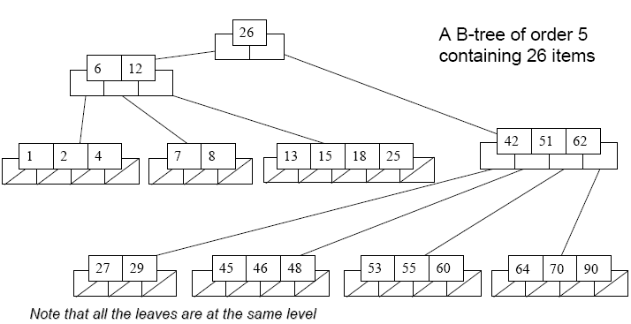
An example B-Tree

Slide 5
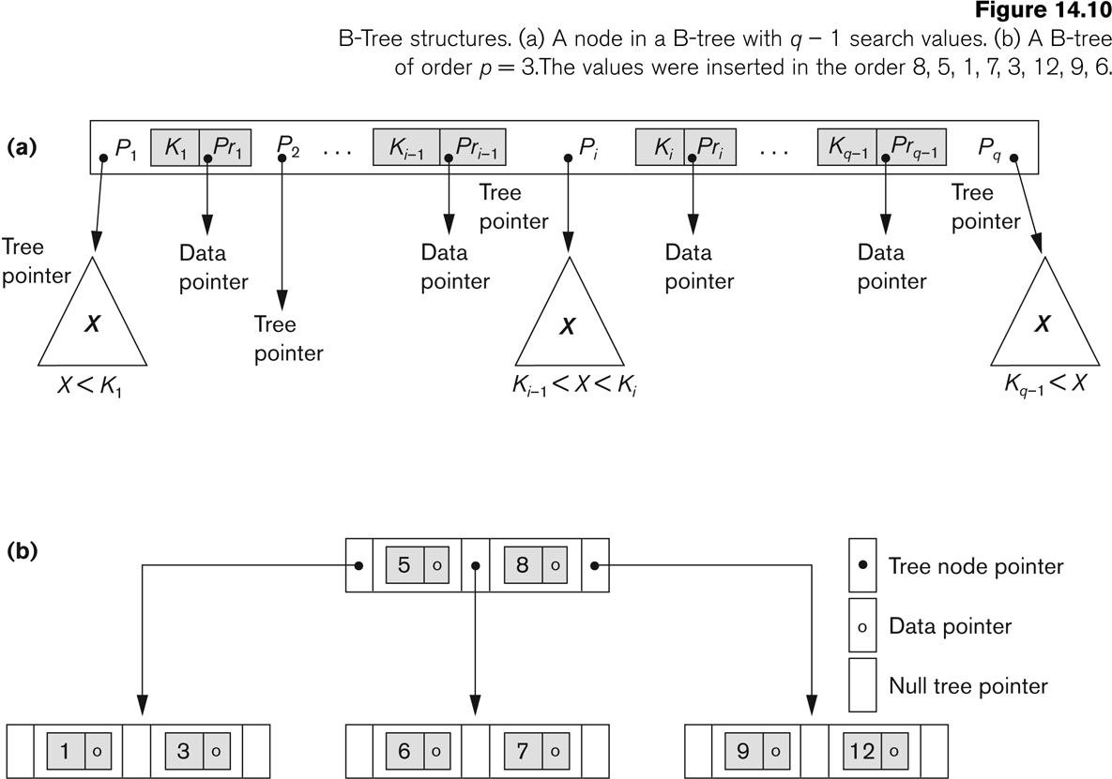
B-tree Structures

Slide 6
Inserting into a B-Tree
Attempt to insert the new key into a leaf
If this would result in that leaf becoming too big, split the leaf into two, promoting the middle key to the leaf’s parent
If this would result in the parent becoming too big, split the parent into two, promoting the middle key
This strategy might have to be repeated all the way to the top
If necessary, the root is split in two and the middle key is promoted to a new root, making the tree one level higher

Slide 7
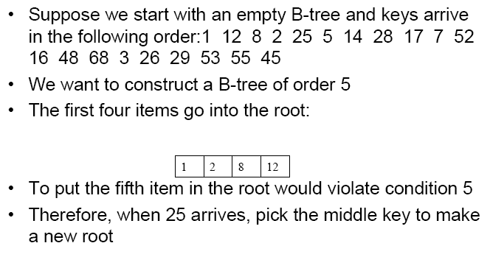
Constructing a B-tree
25
problem

Slide 8
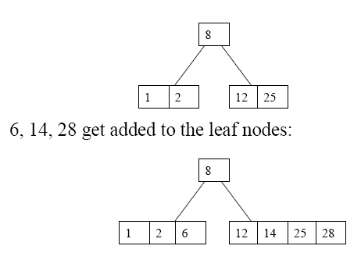
Constructing a B-tree (contd.)
17
problem

Slide 9
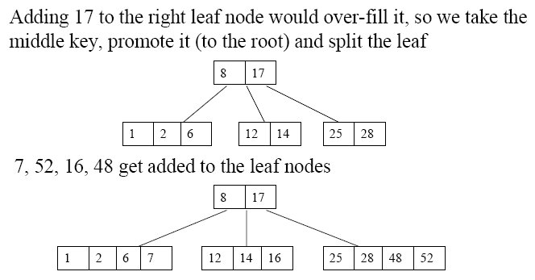
Constructing a B-tree (contd.)
68
problem

Slide 10
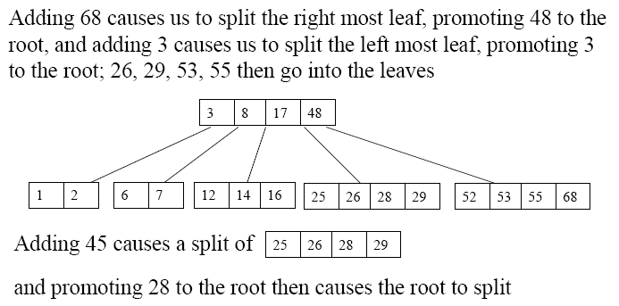
Constructing a B-tree (contd.)
45
problem

Slide 11
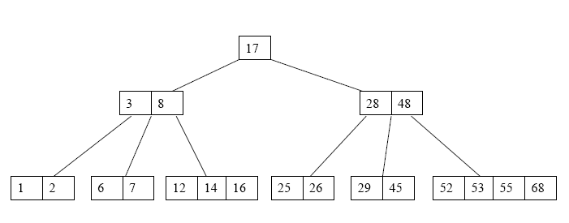
Constructing a B-tree (contd.)

Slide 12
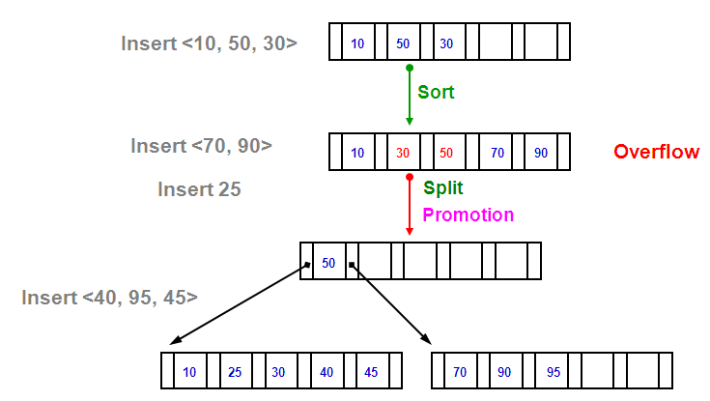
Example of Insertion in B-Tree(1)

Slide 13
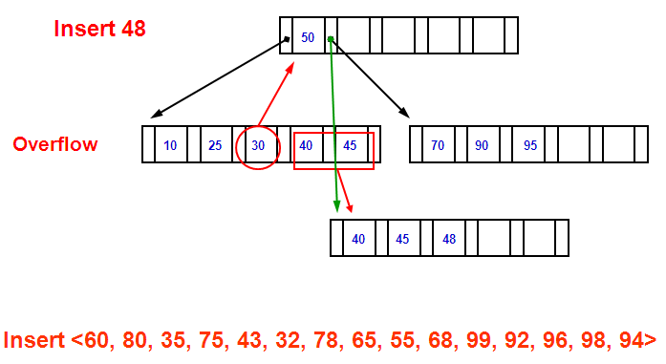
Example of Insertion in B-Tree(2)

Slide 14
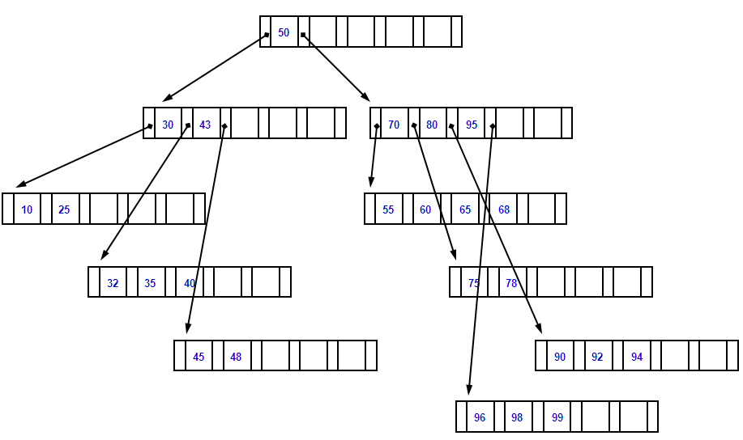
Example of Insertion in B-Tree(3)

Slide 15
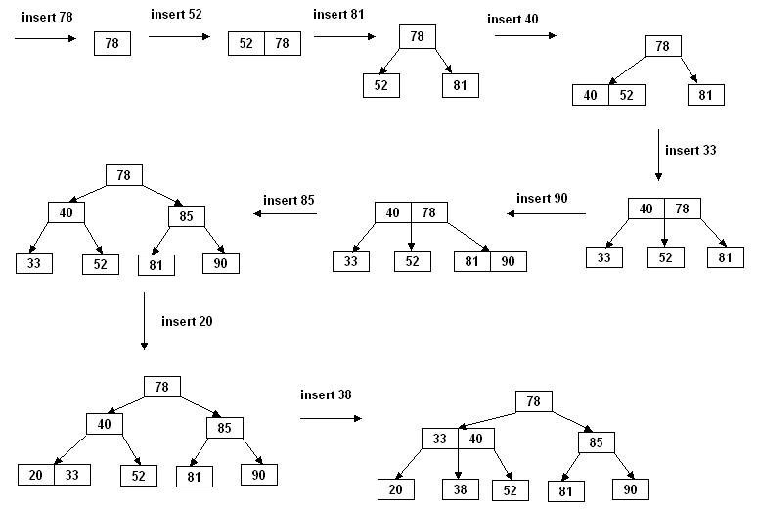
Insertion in a B-tree of odd order
Example: Insert the keys 78, 52, 81, 40, 33, 90, 85, 20, and 38 in this order in an initially empty B-tree of order 3

Slide 16
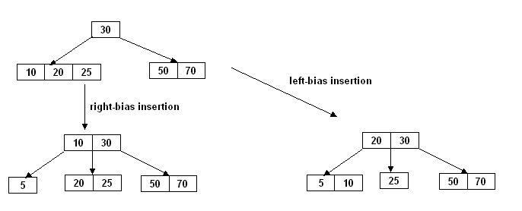
Insertion in a B-tree of even order
At each node the insertion can be done in two different ways:
right-bias: The node is split such that its right subtree has more keys than the left subtree.
left-bias: The node is split such that its left subtree has more keys than the right subtree.
Example: Insert the key 5 in the following B-tree of order 4:

Slide 17
B-Tree Insertion Algorithm
insertKey (x){
if(the key x is in the tree)
throw an appropriate exception;
let the insertion leaf-node be the currentNode;
insert x in its proper location within the node;
if(the currentNode does not overflow)
return;
done = false;
do{
if (m is odd) {
split currentNode into two siblings such that the right sibling rs has m/2 right-most keys,
and the left sibling ls has m/2 left-most keys;
Let w be the middle key of the splinted node;
}
else { // m is even
split currentNode into two siblings by any of the following methods:
right-bias: the right sibling rs has m/2 right-most keys, and the left sibling ls has (m-1)/2 left-most keys.
left-bias: the right sibling rs has (m-1)/2 right-most keys, and the left sibling ls has m/2 left-most keys.
let w be the “middle” key of the splinted node;
}
if (the currentNode is not the root node) {
insert w in its proper location in the parent p of the currentNode;
if (p does not overflow)
done = true;
else
let p be the currentNode;
}
} while (! done && currentNode is not the root node);

Slide 18
B-Tree Insertion Algorithm – Cont.
if (! done) {
create a new root node with w as its only key;
let the right sibling rs be the right child of the new root;
let the left sibling ls be the left child of the new root;
}
return;
}

Slide 19
Removal from a B-tree
During insertion, the key always goes into a leaf. For deletion we wish to remove from a leaf. There are three possible ways we can do this:
1 - If the key is already in a leaf node, and removing it doesn’t cause that leaf node to have too few keys, then simply remove the key to be deleted.
2 - If the key is not in a leaf then it is guaranteed (by the nature of a B-tree) that its predecessor or successor will be in a leaf -- in this case can we delete the key and promote the predecessor or successor key to the nonleaf deleted key’s position.

Slide 20
Removal from a B-tree (2)
If (1) or (2) lead to a leaf node containing less than the minimum number of keys then we have to look at the siblings immediately adjacent to the leaf in question:
– 3: if one of them has more than the min’ number of keys then we can promote one of its keys to the parent and take the parent key into our lacking leaf
– 4: if neither of them has more than the min’ number of keys then the lacking leaf and one of its neighbors can be combined with their shared parent (the opposite of promoting a key) and the new leaf will have the correct number of keys; if this step leave the parent with too few keys then we repeat the process up to the root itself, if required

Slide 21
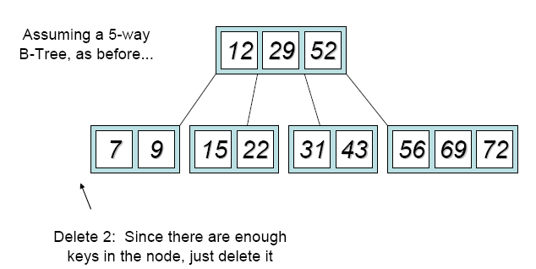
Type #1: Simple leaf deletion
52
2

Slide 22
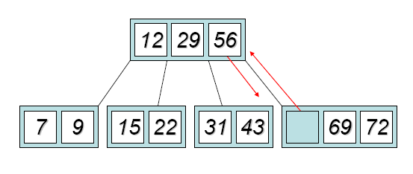
Type #2: Simple non-leaf deletion
52

Slide 23
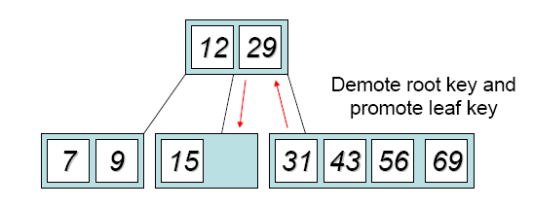
Type #3: Enough siblings
22

Slide 24
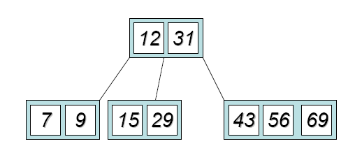
Type #3: Enough siblings

Slide 25
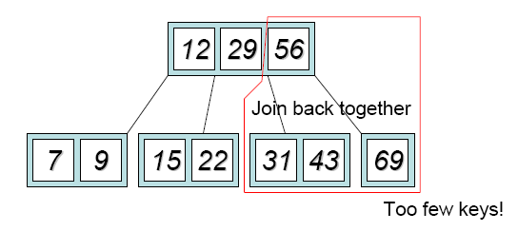
Type #4: Too few keys in node and its siblings
72

Slide 26
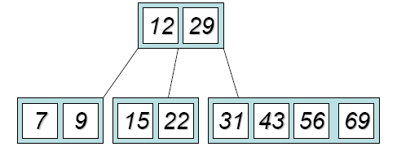
Type #4: Too few keys in node and its siblings

Slide 27
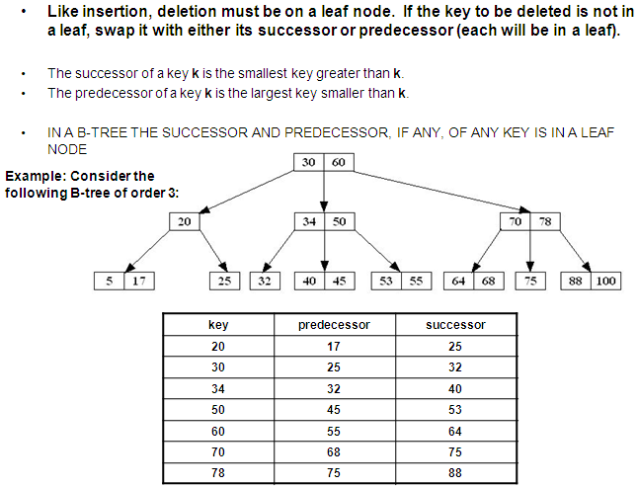
Deletion in B-Tree

Slide 28
Deletion in B-Tree
UNDERFLOW CONDITION
A non-root node of a B-tree of order m underflows if, after a key deletion, it contains ⎡m / 2⎤ - 2 keys
The root node does not underflow. If it contains only one key and this key is deleted, the tree becomes empty.

Slide 29
Deletion in B-Tree
Deletion algorithm:
If a node underflows, rotate the appropriate key from the adjacent right- or left-sibling if the sibling contains at least ⎡m / 2⎤ keys; otherwise perform a merging.
A key rotation must always be attempted before a merging
There are five deletion cases:
1. The leaf does not underflow.
2. The leaf underflows and the adjacent right sibling has at least ⎡m / 2 ⎤ keys.
perform a left key-rotation
3. The leaf underflows and the adjacent left sibling has at least ⎡m / 2 ⎤ keys.
perform a right key-rotation
4. The leaf underflows and each of the adjacent right sibling and the adjacent left sibling has at least ⎡m / 2 ⎤ keys.
perform either a left or a right key-rotation
5. The leaf underflows and each adjacent sibling has ⎡m / 2⎤ - 1 keys.
perform a merging

Slide 30
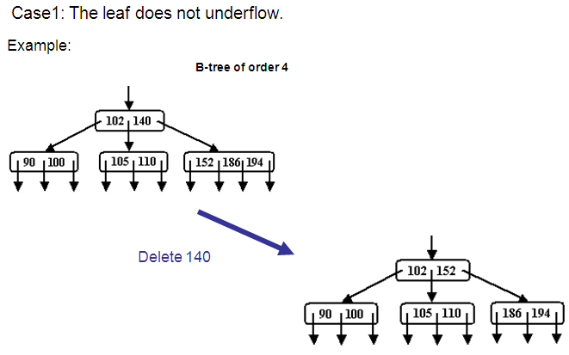
Deletion in B-Tree

Slide 31
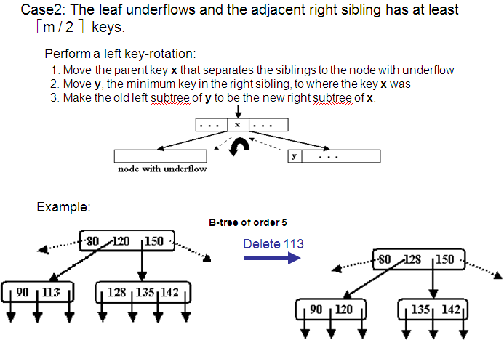

Slide 32
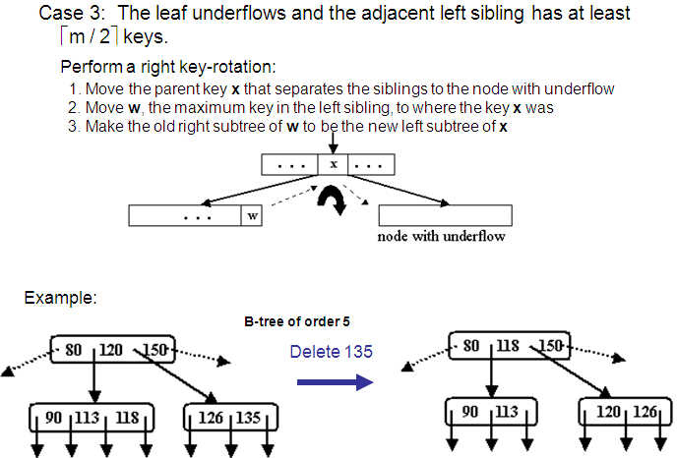

Slide 33
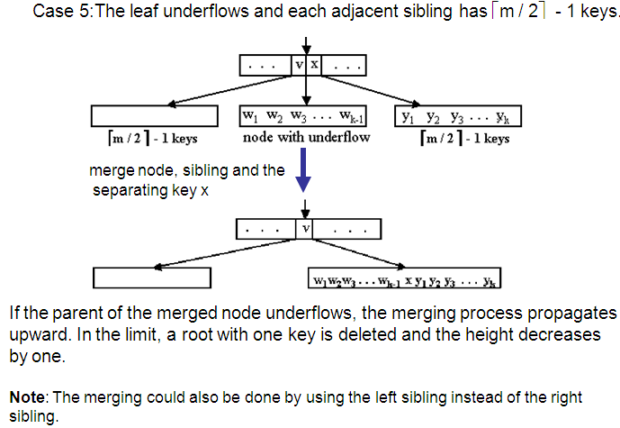

Slide 34
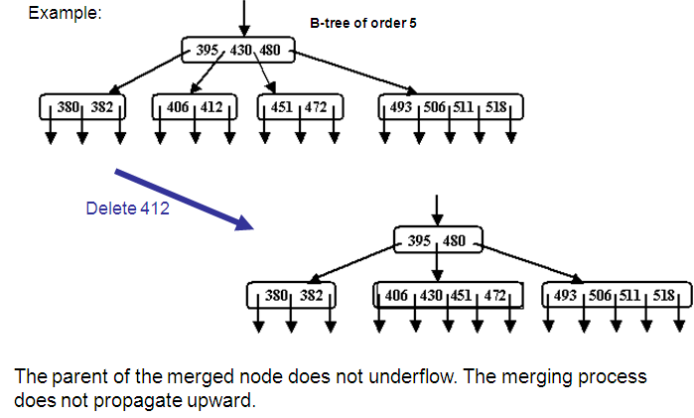

Slide 35
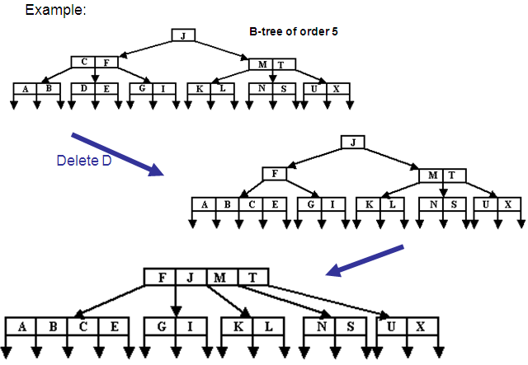
problem

Slide 36
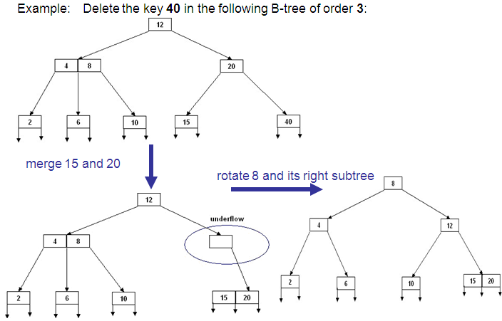

Slide 37
B-Tree Deletion Algorithm
deleteKey (x) {
if (the key x to be deleted is not in the tree)
throw an appropriate exception;
if (the tree has only one node) {
delete x ;
return;
}
if (the key x is not in a leaf node)
swap x with its successor or predecessor;
// each will be in a leaf node
delete x from the leaf node;
if(the leaf node does not underflow)
// after deletion numKeys ≥ ⎡m / 2⎤ - 1
return;
let the leaf node be the CurrentNode;
done = false;

Slide 38
while (! done && numKeys(CurrentNode) < ⎡m / 2⎤ - 1) { // there is underflow
if (any of the adjacent siblings t of the CurrentNode has at least ⎡m / 2⎤ keys) {
// ROTATION CASE
if (t is the adjacent right sibling) {
rotate the separating-parent key w of CurrentNode and t to CurrentNode;
rotate the minimum key of t to the previous parent-location of w;
rotate the left subtree of t, if any, to become the right-most subtree of CurrentNode;
}
else { // t is the adjacent left sibling
rotate the separating-parent key w between CurrentNode and t to CurrentNode;
rotate the maximum key of t to the previous parent-location of w;
rotate the right subtree of t , if any, to become the left-most subtree of CurrentNode;
}
done = true;
}
else { // MERGING CASE: the adjacent or each adjacent sibling has ⎡m / 2⎤ - 1 keys
select any adjacent sibling t of CurrentNode;
create a new sibling by merging currentNode, the sibling t, and their parent-separating key ;
If (parent node p is the root node) {
if (p is empty after the merging)
make the merged node the new root;
done = true;
} else
let parent p be the CurrentNode;
}
} // while
return;
}

Slide 39
Analysis of B-Trees
The maximum number of items in a B-tree of order m and height h:
root m – 1
level 1 m(m – 1)
level 2 m2(m – 1)
. . .
level h m (m – 1)
So, the total number of items is
(1 + m + m2 + m3 + … + m )(m – 1) =
[(m – 1)/ (m – 1)] (m – 1) = m – 1
When m = 5 and h = 2 this gives 5^3 – 1 = 124
h
h
h+1
h+1

Slide 40
Implementing an ADT
Using the example of implementing a BTree, are there any general principles that we can follow when implementing an abstract data type (ADT)?

Slide 41
Example: Implementing a B-Tree
Consider a request to store all actors
(male and female) since 1900.
Say there are too many to store in a computer’s memory, then we need to use a B-Tree because it’s the most time efficient way of adding, updating, retrieving (and maybe deleting) records.
How do we begin to code this problem?

Slide 42
1 - What classes are required?
What are the ‘things’ in the problem specification?
Firstly there are records of individual actors -- lots of them.
Secondly we have decided to use a B-Tree to store them, which itself will contain classes:
– A BKey class to hold each Record
– A BNode class to hold a number of keys
– A B-Tree class as a wrapper around the linked BNode objects
Anything else?
Would you do it differently?

Slide 43
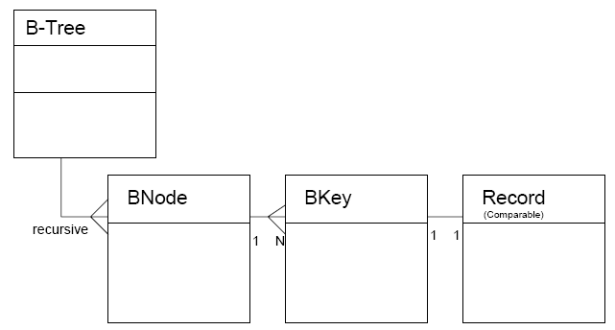
2 - What are the class interactions?

Slide 44
3 - What are the algorithms?
Insertion: when a node becomes too full, split it into two nodes and promote the middle key into a parent key. Repeat recursively on the parent key.
Deletion: delete (always, in principle, from a leaf) using rules on slides 11 and 12.

Slide 45
4 - What data struct’s are required?
B-Tree: Contains a pointer Node top; to the top Node object.
BNode: Contains an array BKey[] keys; of Key objects and a pointer Node parent;
BKey: Contains a Record and two pointers to child BNode objects.
Record: Depends on the application, but will always implement the Comparable interface. In this application it contains a String name; and an array String[] inFilms;

Slide 46
5 - What methods are required?
Start with the methods for the most basic classes (those that only use existing classes, not the ones you’re coding)
These will act on the data structures to (i) create, (ii) update, (iii) retrieve, and/or (iv) delete. There may be a number of methods for each of these operations.
Start coding the most basic classes, and test with a main() method in each class.

